Slide 1
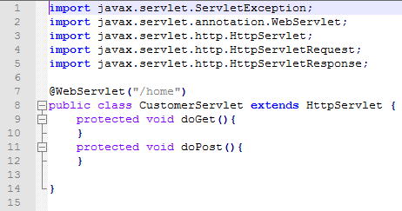

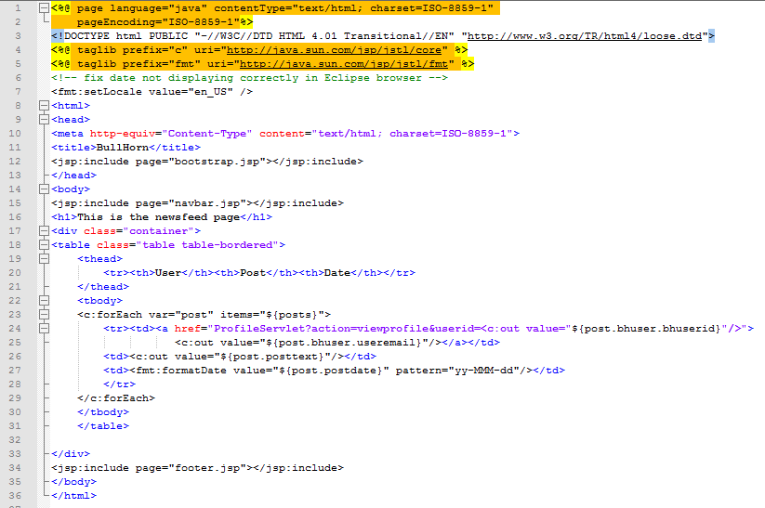

Slide 2

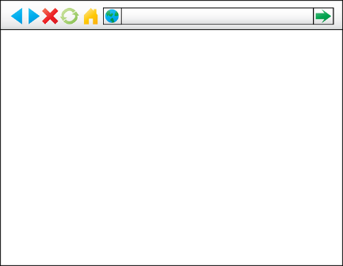
Model View Controller
Data
Database Utility Classes (model)
Servlet
Oracle Database (Model)
Controller
Entity Classes (Model)
Java
Java Server Pages (JSP)
(view)
Browser
(view)

Slide 3
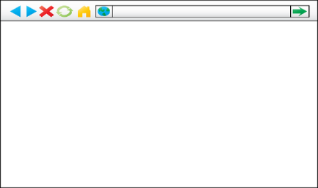
Model View Controller
Java
Servlet
Java Server Pages (JSP)
(View)
Browser
(view)
Controller
Oracle Database (Model)

Slide 4
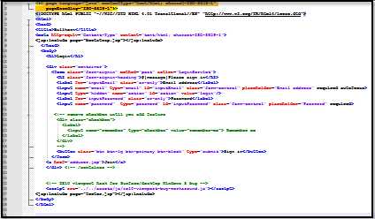
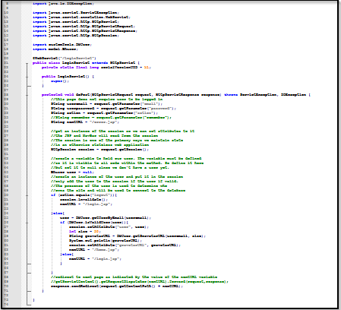
Bullhorn
Data
Database Utility Classes (model)
Entity Classes (Model)
Oracle Database (Model)
Java
Java Server Pages (JSP)
(view)
Servlet
Servlet
Controller
Controller

Slide 5
Servlets
Data
Database Utility Classes (model)
Entity Classes (Model)
Oracle Database (Model)
Java
Java Server Pages (JSP)
(view)
Servlet
Servlet
Controller
Controller

Slide 6
Java Server Pages

Slide 7
Data Model

Slide 8
